Slide 1
DEV JATINBHAI PATEL
CE076
20CEUOS018
DBMS-LAB8

Slide 2
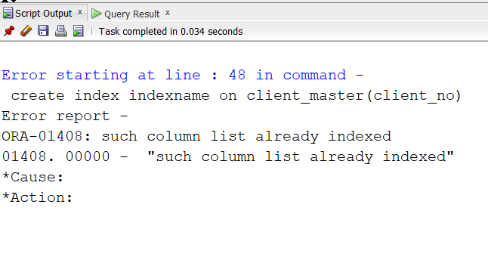
Create an index on the table client_master, field client_no.
A).As , here client_no is primary key , we will get this error.
create index indexname on client_master(client_no);

Slide 3
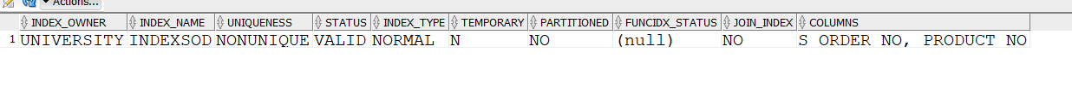
2. Create a composite index on the sales_order_details table for the columns s_order_no and product_no.
A). create index indexsod on sales_order_details(s_order_no,product_no);

Slide 4
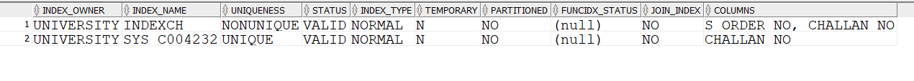
3.Create a composite index ch_index on challan_header table for the columns challan no and s_order_no.
A). create index indexch on challan_header(s_order_no,challan_no);

Slide 5
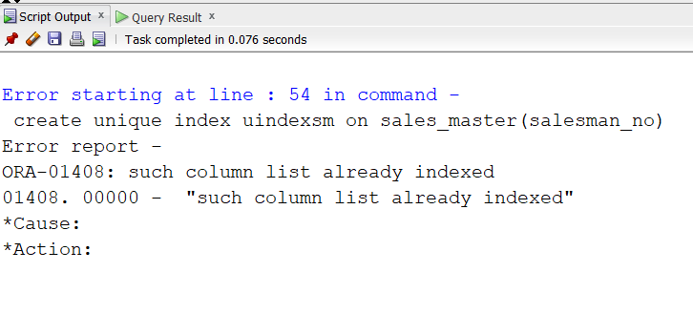
4. Create a unique index on the table sales_master, field salesman_no.
create unique index uindexsm on sales_master(salesman_no);
As , here salesman_no is primary key , we will get this error.

Slide 6
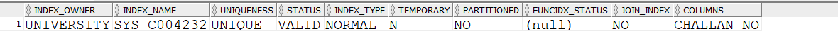
Drop index of table challan_header.
drop index indexch;

Slide 7
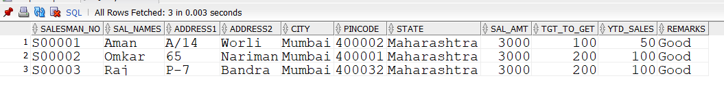
6. Create view on salesman_master whose sal_amt is less than 3500.
create view viewsm as select salesman_no, sal_names,address1
,address2,city,pincode,state,sal_amt,tgt_to_get,ytd_sales,remarks
from sales_master where sal_amt < '3500’;
select * from viewsm;

Slide 8
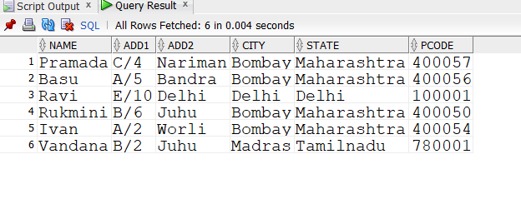
7. Create a view client_view on client_master and rename the columns as name, add1, add2, city, pcode, state respectively.
CREATE VIEW client_view(name,add1,add2,city,state,pcode) AS
(SELECT name,address1,address2,city,state,pincode FROM client_master);
SELECT * FROM client_view;

Slide 9
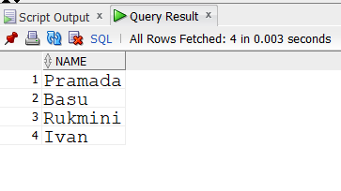
8.Select the client names from client_view who lives in city ‘Bombay’.
SELECT name FROM client_view where city = 'Bombay';

Slide 10
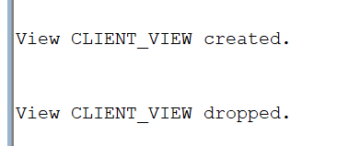
9.Drop the view client_view.
drop view client_view;

